Slide 1
Employee Data Analysis using Excel
STUDENT NAME: Prajith Sanjeev D
REGISTER NO: 312207829
DEPARTMENT: Bcom ( Accounting and Finance)
COLLEGE: The Quaide Millet college for men,
medavakkam, Chennai -600100.

Slide 2
PROJECT TITLE
Employee Performance Analysis using Excel
Present By;
Prajith Sanjeev D
On 28/08/2024

Slide 3


AGENDA
Problem Statement
Project Overview
End Users
Our Solution and Proposition
Dataset Description
Modelling Approach
Results and Discussion
Conclusion
3/21/2024 Annual Review

Slide 4

PROBLEM STATEMENT
Headline:
The Challenge: Understanding and Improving Employee Performance .
Bullet Points:
Traditional performance reviews are often subjective and inconsistent.
Lack of data-driven insights makes it difficult to identify areas for improvement.
Organizations struggle to effectively track and measure progress.

Slide 5

PROJECT OVERVIEW
Headline: Our Goal: Data-Driven Performance Insight
Bullet points:
Develop a structured approach to employee performance analysis using Excel.
Leverage readily available data to gain valuable insights.
Create a framework for continuous improvement and development.

Slide 6
WHO ARE THE END USERS?
Headline: Who Benefits?
Bullet points:
HR Managers and Recruiters
Team Leaders and Supervisors
Employees themselves (for self-improvement)
Executive Management (for strategic decision-making)

Slide 7

OUR SOLUTION AND ITS VALUE PROPOSITION
Headline: The Excel Solution: A Powerful Tool for Performance Analysis
Bullet points:
Utilizing Excel’s capabilities for data manipulation, visualization, and analysis.
Creating dashboards and reports to track key performance indicators (KPIs)
Providing a cost-effective and accessible solution.

Slide 8
Dataset Descriptions
Headline: The Data We'll Analyze
Bullet points:
Employee demographics (age, tenure, department, etc.)
Performance metrics (sales figures, customer satisfaction ratings, project completion rates, etc.)
Visual: A sample table showing the dataset structure (if possible)

Slide 9
THE "WOW" IN OUR SOLUTION
Technique and memorable Experience During the Onboarding Process that leave a lasting Impression on us
These moments typically evoke Positive emotions and establish a strong connection between the Employee and Organization.
9

Slide 10
MODELLING
Headline: Data Modelling
Bullet points:
Interview results were then transformed to tabular format for better analysis
Interview results are then cleaned and updated for better analysis
Created new columns for Organization structure and HR & Others with standard terminology and group departments into HR and Others.
10

Slide 11
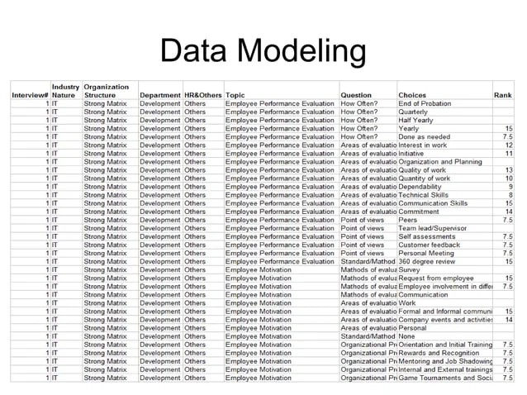
Employee Data analytics using Excel:

Slide 12
RESULTS
Hope we Learned how employees Data are analyzed using Excel from the PPT presented .
The procedures involved in analysis of employees Data using Excel is observed.
12

Slide 13

Conclusion :

